Slide 1

Sleep Health and Lifestyle Dataset
Presented by :
BOGA VIGNESH SATHISH
2203A52075
BAIRI RAGHAVENDRA
2203A52073
TO:
Ramesh Dadi
faculty of STATML

Slide 2
INTRODUCTION:
Unlock sleep insights with the Sleep Health Dataset
The Sleep Health and Lifestyle Dataset comprises 400 rows and 13 columns, covering a wide range of variables related to sleep and daily habits. It includes details such as gender, age, occupation, sleep duration, quality of sleep, physical activity level, stress levels, BMI category, blood pressure, heart rate, daily steps, and the presence or absence of sleep disorders.

Slide 3
Key Features of the Dataset:
Comprehensive Sleep Metrics: Explore sleep duration, quality, and factors influencing sleep patterns. Lifestyle Factors: Analyze physical activity levels, stress levels, and BMI categories. Cardiovascular Health: Examine blood pressure and heart rate measurements. Sleep Disorder Analysis: Identify the occurrence of sleep disorders such as Insomnia and Sleep Apnea.

Slide 4
Dataset Columns: Person ID: An identifier for each individual. Gender: The gender of the person (Male/Female). Age: The age of the person in years. Occupation: The occupation or profession of the person. Sleep Duration (hours): The number of hours the person sleeps per day. Quality of Sleep (scale: 1-10): A subjective rating of the quality of sleep, ranging from 1 to 10. Physical Activity Level (minutes/day): The number of minutes the person engages in physical activity daily. Stress Level (scale: 1-10): A subjective rating of the stress level experienced by the person, ranging from 1 to 10. Sleep Disorder: The presence or absence of a sleep disorder in the person (None, Insomnia, Sleep Apnea).

Slide 5
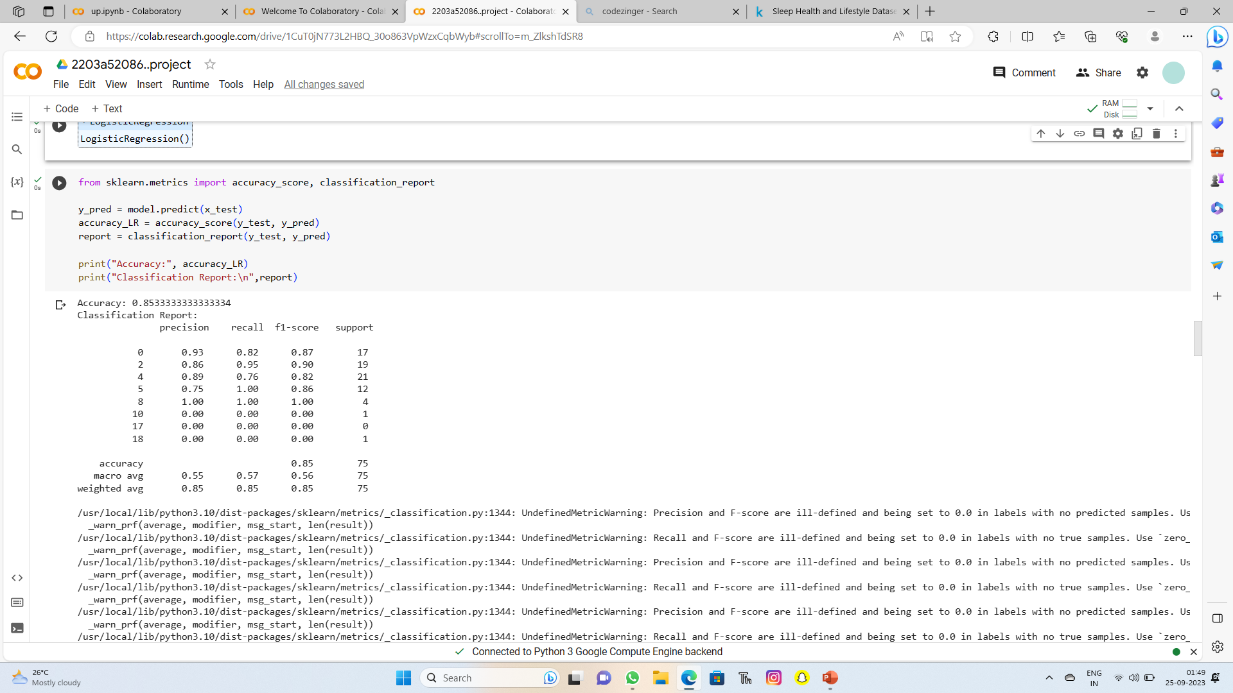
SCREEN SHORT:

Slide 6

IMPLEMENTATION
Supervised Learning
Parametric Approach
Classification
Logistical Regression
Perceptron Learning
SVM classifier
K-NearestNeighbors(KNN)
Bootstrapped Logistic Regression
Bootstrapped svm

Slide 7
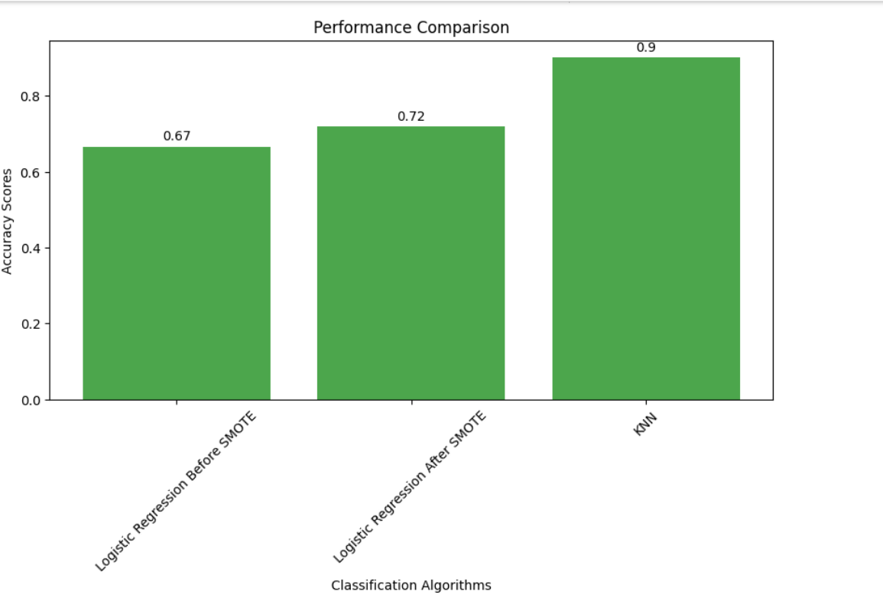
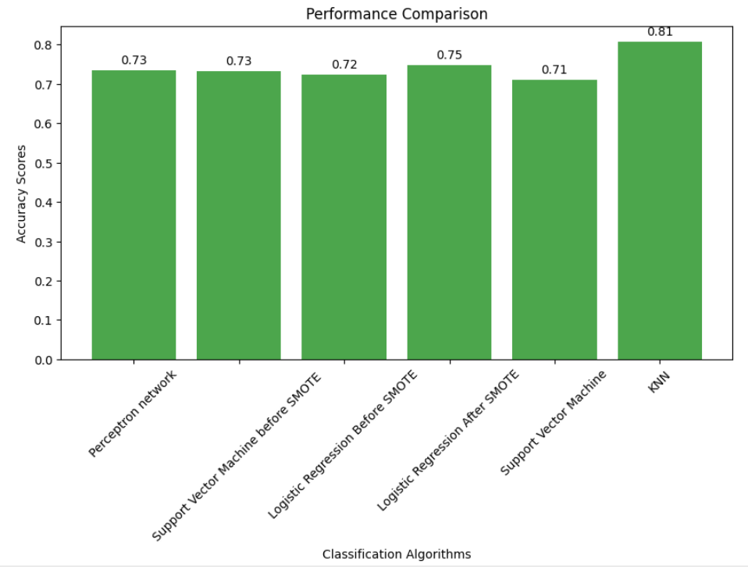
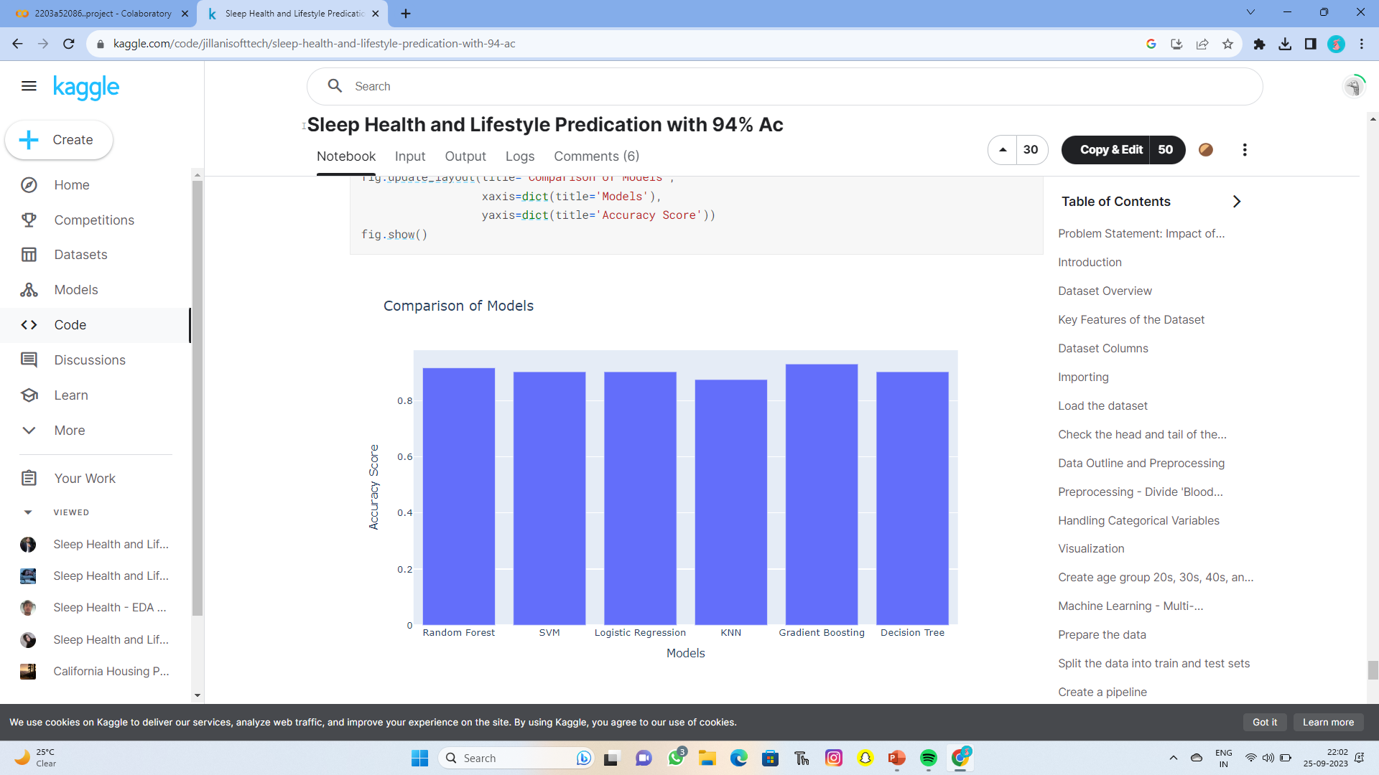
RESULT ANALYSIS : my performance comparision: Kaggle comparison model:

Slide 8
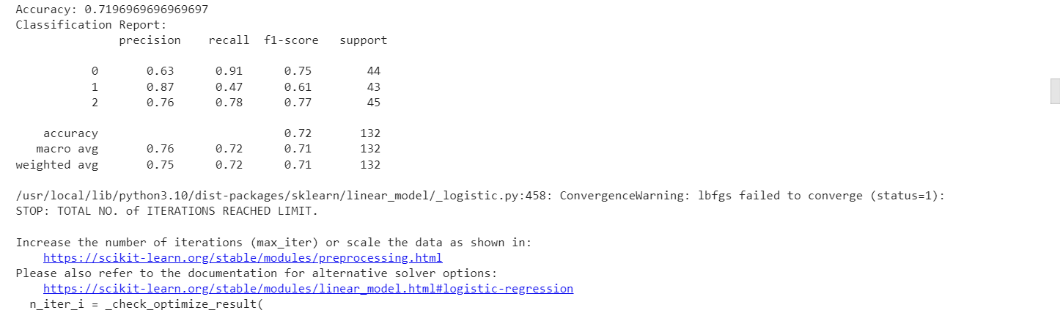
Logistic Regression Sleep is something that affects the way of life of humans. Whether it is about education, work, driving a vehicle, or even the health problems caused by insufficient rest, such as heart disease, diabetes, obesity, and more, especially nowadays, the disease that affects sleep. Asleep is caused by social pressures such as insomnia, depression, and most people with this disease tend to be unaware of it. Some cases, the condition may lead to suicide

Slide 9
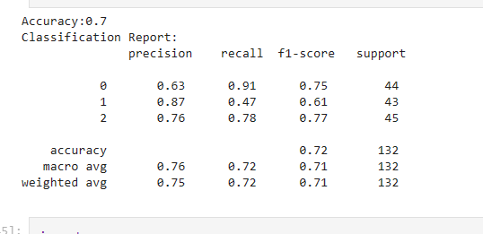
SVM classifier:

Slide 10
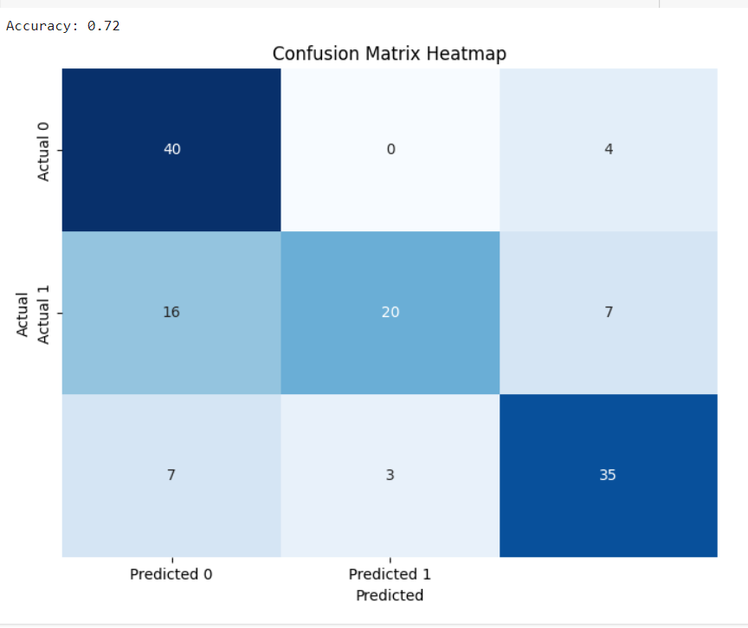
Confusion matrix:

Slide 11

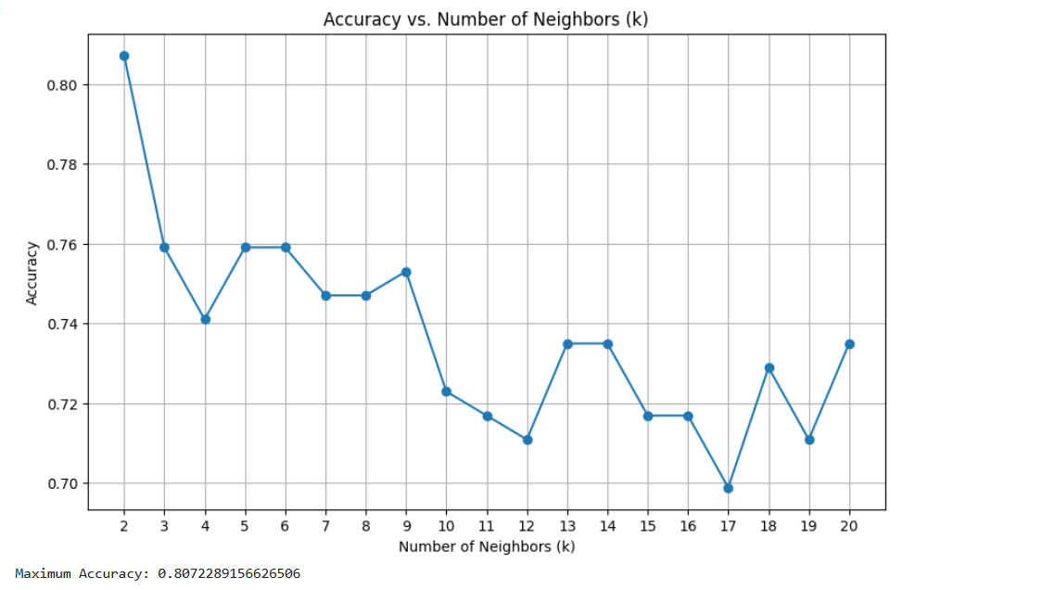
K-NearestNeighbors(KNN): The K-Nearest Neighbor (KNN) algorithm is a popular machine learning technique used for classification and regression tasks. It relies on the idea that similar data points tend to have similarlabels.

Slide 12
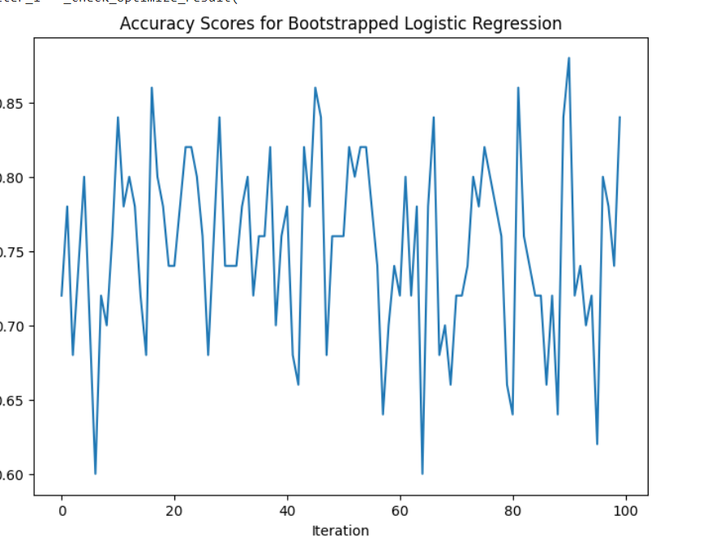
Bootstrapped Logistic Regression: Bootstrapping is rapidly becoming a popular alternative tool to estimate parameters and standard errors for logistic regression model. Bootstrap is a computer intensive method that can be used to estimate variability of estimators, estimate probabilities and quantile related to test statistics or to construct confidence intervals, explore the shape of distribution of estimators

Slide 13
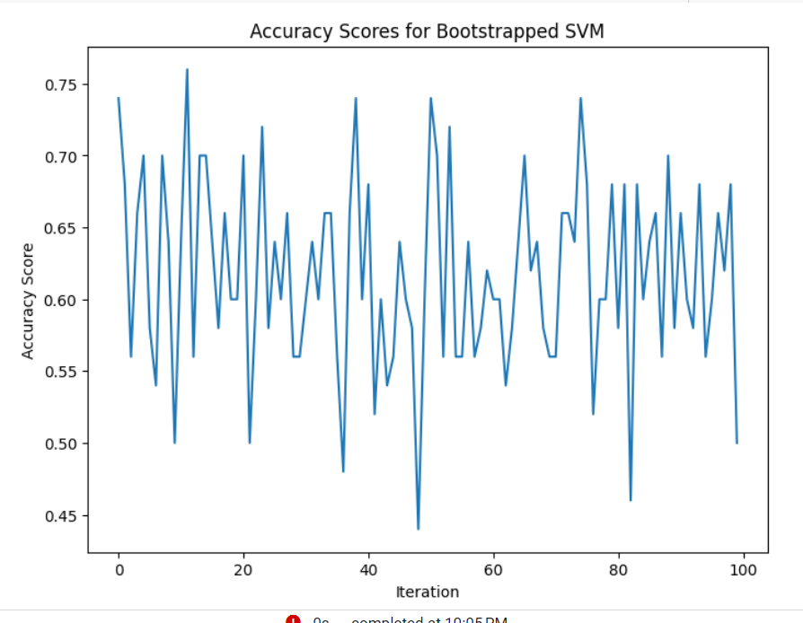
Bootstrapped svm:

Slide 14
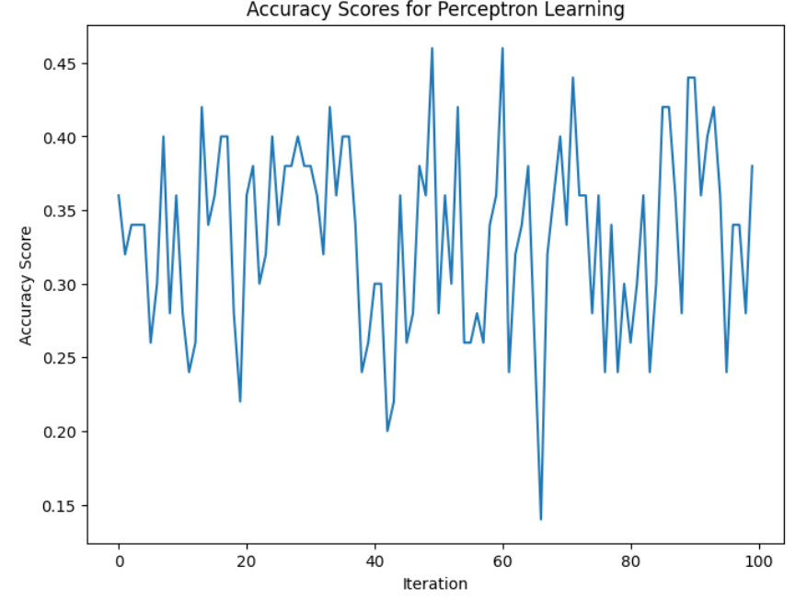
Conclusion: The Sleep Health and Lifestyle Dataset is a comprehensive dataset that provides valuable insights into sleep patterns and daily habits By svm ,logestric regression and K-NearestNeighbors(KNN) Bootstrapped Logistic Regression Bootstrapped svm

Slide 15
Git hub link: https://github.com/Bogavignesh/2073-2075.review2/blob/main/2073%262075_review2.ipynb

